Slide 1

Industry Project Graduate Diploma in Data Analytics Li Zhang 170010801

Slide 2

Background of Client
ABSL
Auckland Basketball Services Limited
Charitable sports company that specializes in the delivery of basketball programs, leagues, competitions, educational frameworks and events.
Servicing Counties-Manukau Basketball, Waitakere West Auckland Basketball and Basketball Auckland regions.

Slide 3
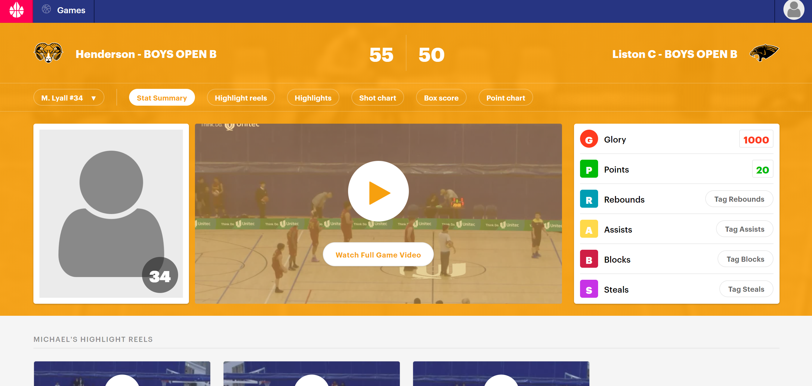

BASKETBALL'S AUTOMATED VIDEO ENGAGEMENT SYSTEM
Glory League is a fully automated cost-effective video engagement system for amateur basketball. It makes everyday players feel like NBA superstars with professional quality full game video, personal highlight reels and stats.
Each point scored is cut into a highlight video for the player involved. Every player, coach, parent or supporter is emailed a link to the game video, player highlights and statistics.
Background of Platform

Slide 4

A website user is a person who is accessing, browsing or interacting with a website, and user behavior refers to how people use a website. Behaviors include everything from the journey they take through the site to interactions such as clicks.
Companies can learn a lot from visitors’ behavior and use the insight to improve user experiences and conversion rates.
----------- Esther Ward
User Behavior

Slide 5
Descriptive analytics is a conventional form of business intelligence and data analysis by providing the summary view of facts and figures in an understandable format, it presents past data about past events for the benefit of a wide business audience with data aggregation and data mining techniques.
As data-driven business continue to use the results from descriptive analytics to enhance their decision-making powers, data analytics will move further away from predictive analytics toward prescriptive analytics.
----------- Paramita Ghosh
Descriptive Analysis

Slide 6

MOV
Measurable Organizational Value
Improve the click rate and enhance the engagement of users achieved by user behavior analysis, which will benefit to decision making, impact on financial area( fund raising) and generate advertising revenue.

Slide 7

Expectations
Statistical analysis, evaluation and review of the interactivity of the online APP
Deliverables
Tableau Dashboard show the statistical analysis of users’ usage pattern and behavior habit and Industry Project Report
Introduction
Scope
Limited to ABSL users’ usage behavior around New Zealand about OS, timestamp, region and pages

Slide 8

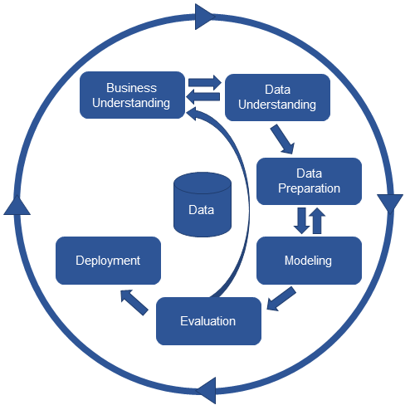
Methodology
CRISP-DM

Slide 9
Plan

Slide 10
Weekly
Schedule

Slide 11
Project Process
Email
Meeting
Website/Platform
Literature Review
Data Obtaining
Data Pre-processing
Email/Meeting
2. Data Understanding
1. Business
Understanding
DATA
Dashboard Design
Descriptive Analysis
Recommendation
4. Modelling & Evaluation
3. Data Preparation
Data Transformation
Primary Analysis

Slide 12
Data Preparation
Data Extraction
Data Transformation

Slide 13
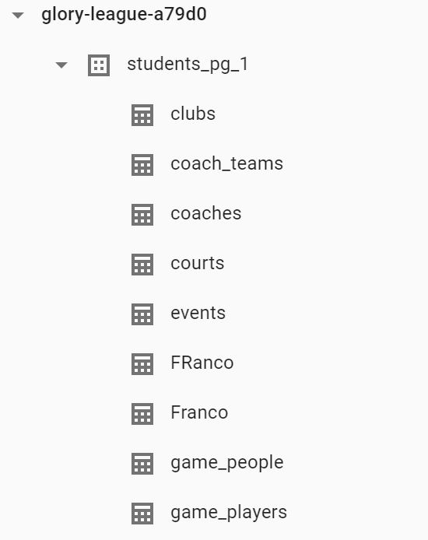
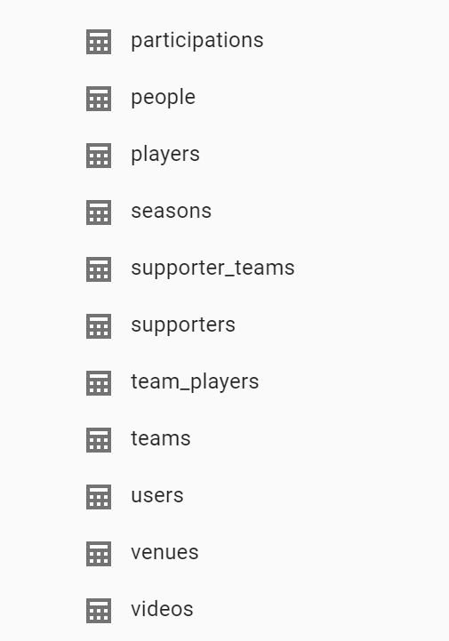
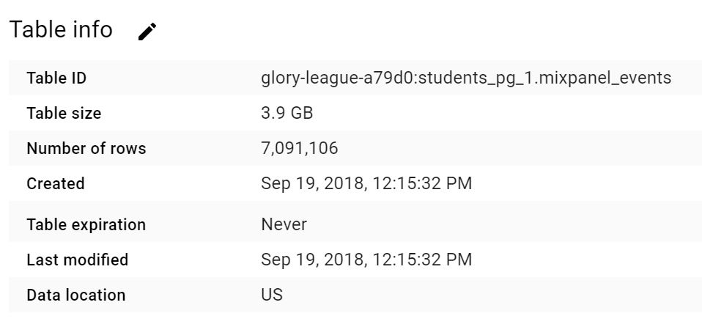
Data Preparation

Slide 14
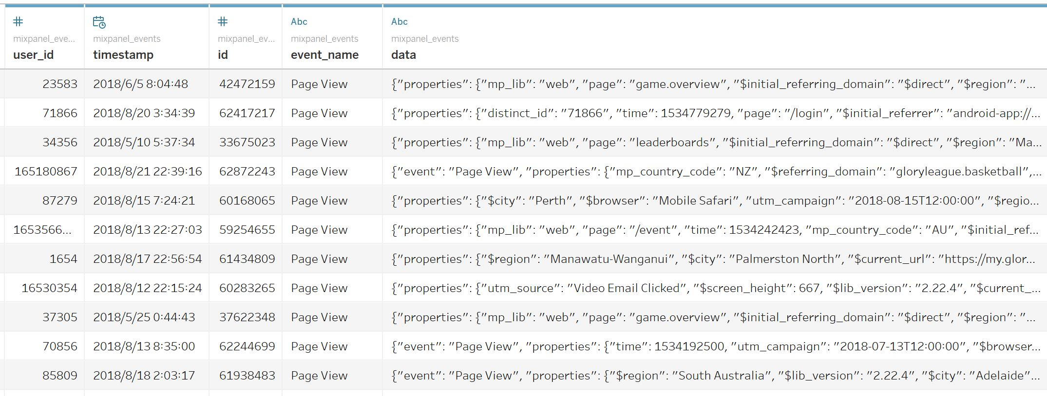
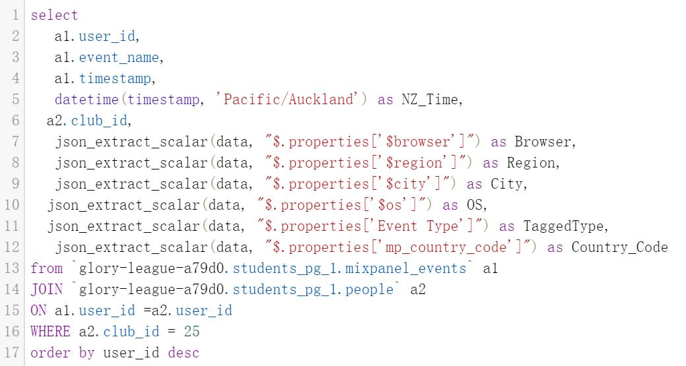
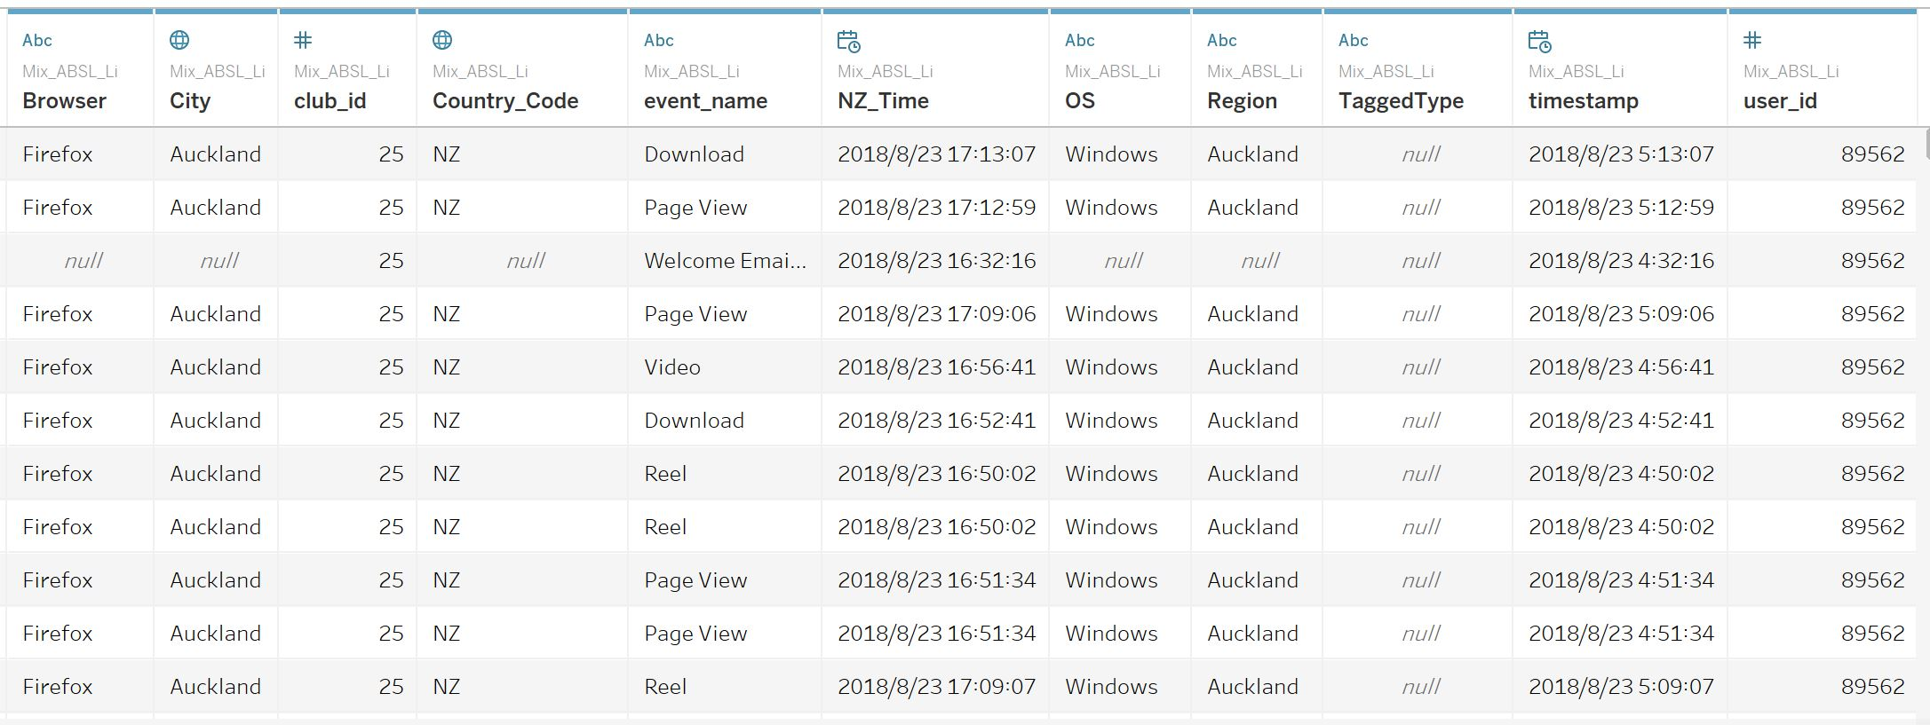
Data Preparation

Slide 15

1,756,095 samples
4,740 users
through 4 years

Slide 16
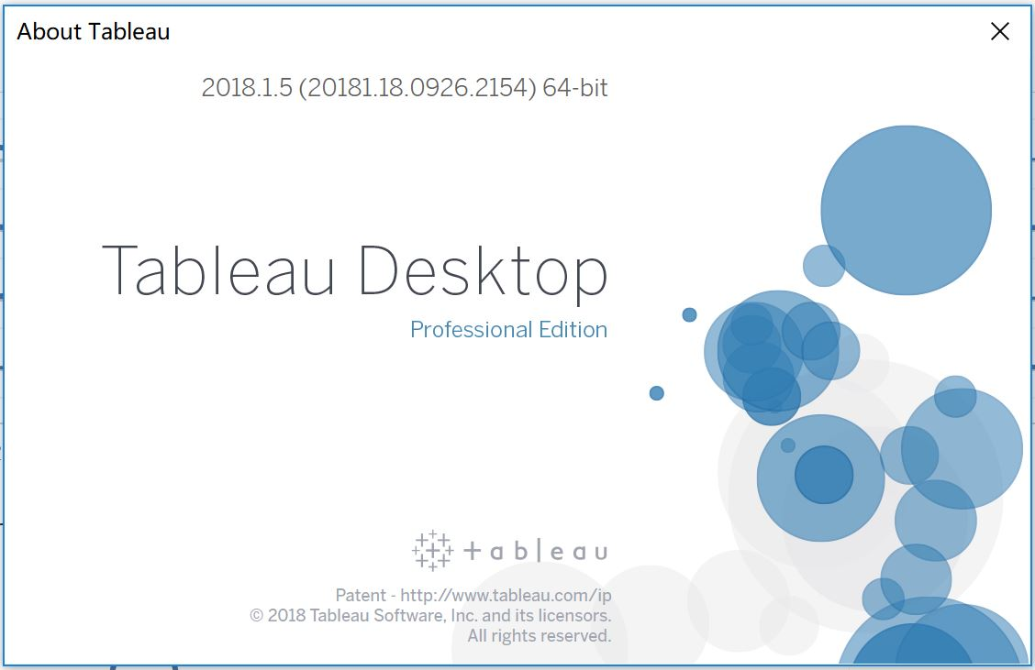
Dashboard Design & Descriptive Analysis

Slide 17
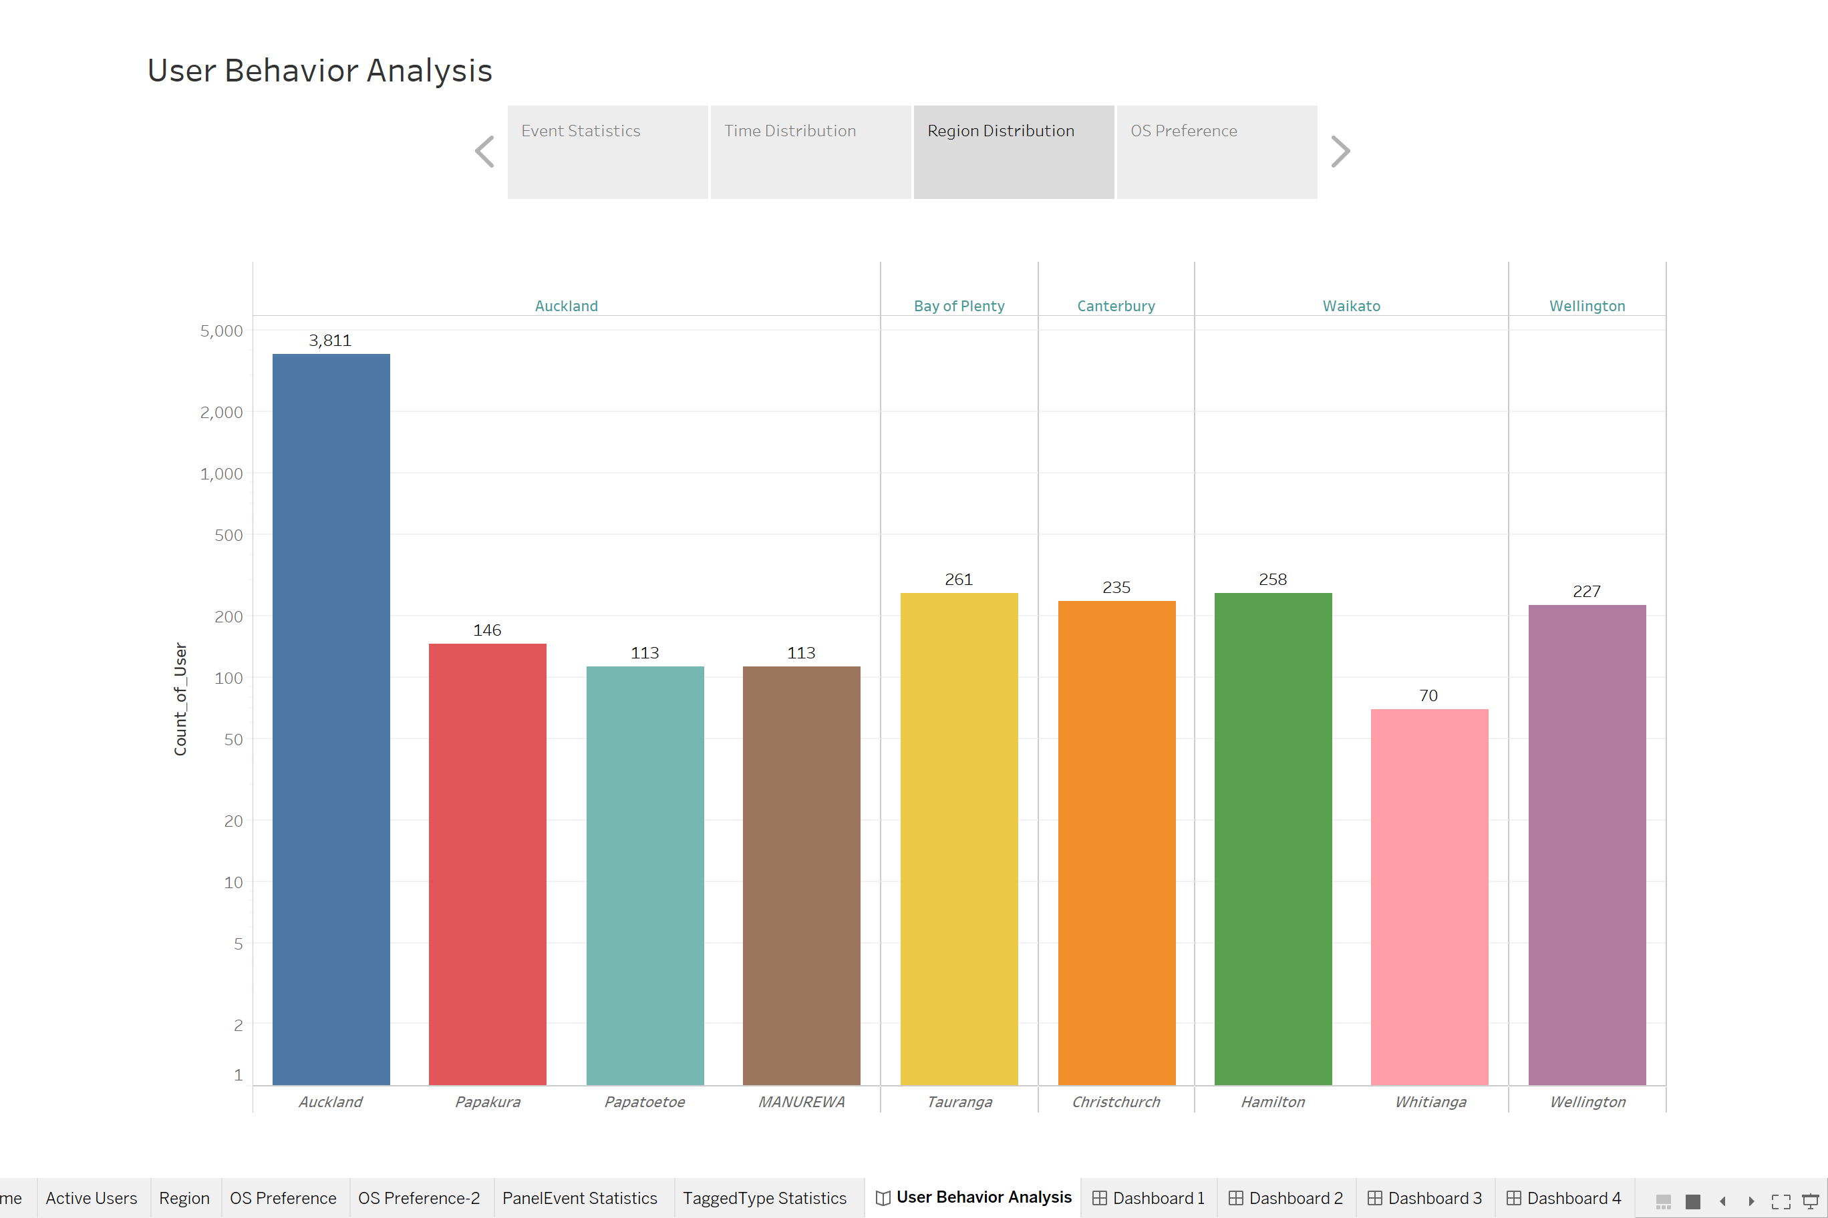

Slide 18
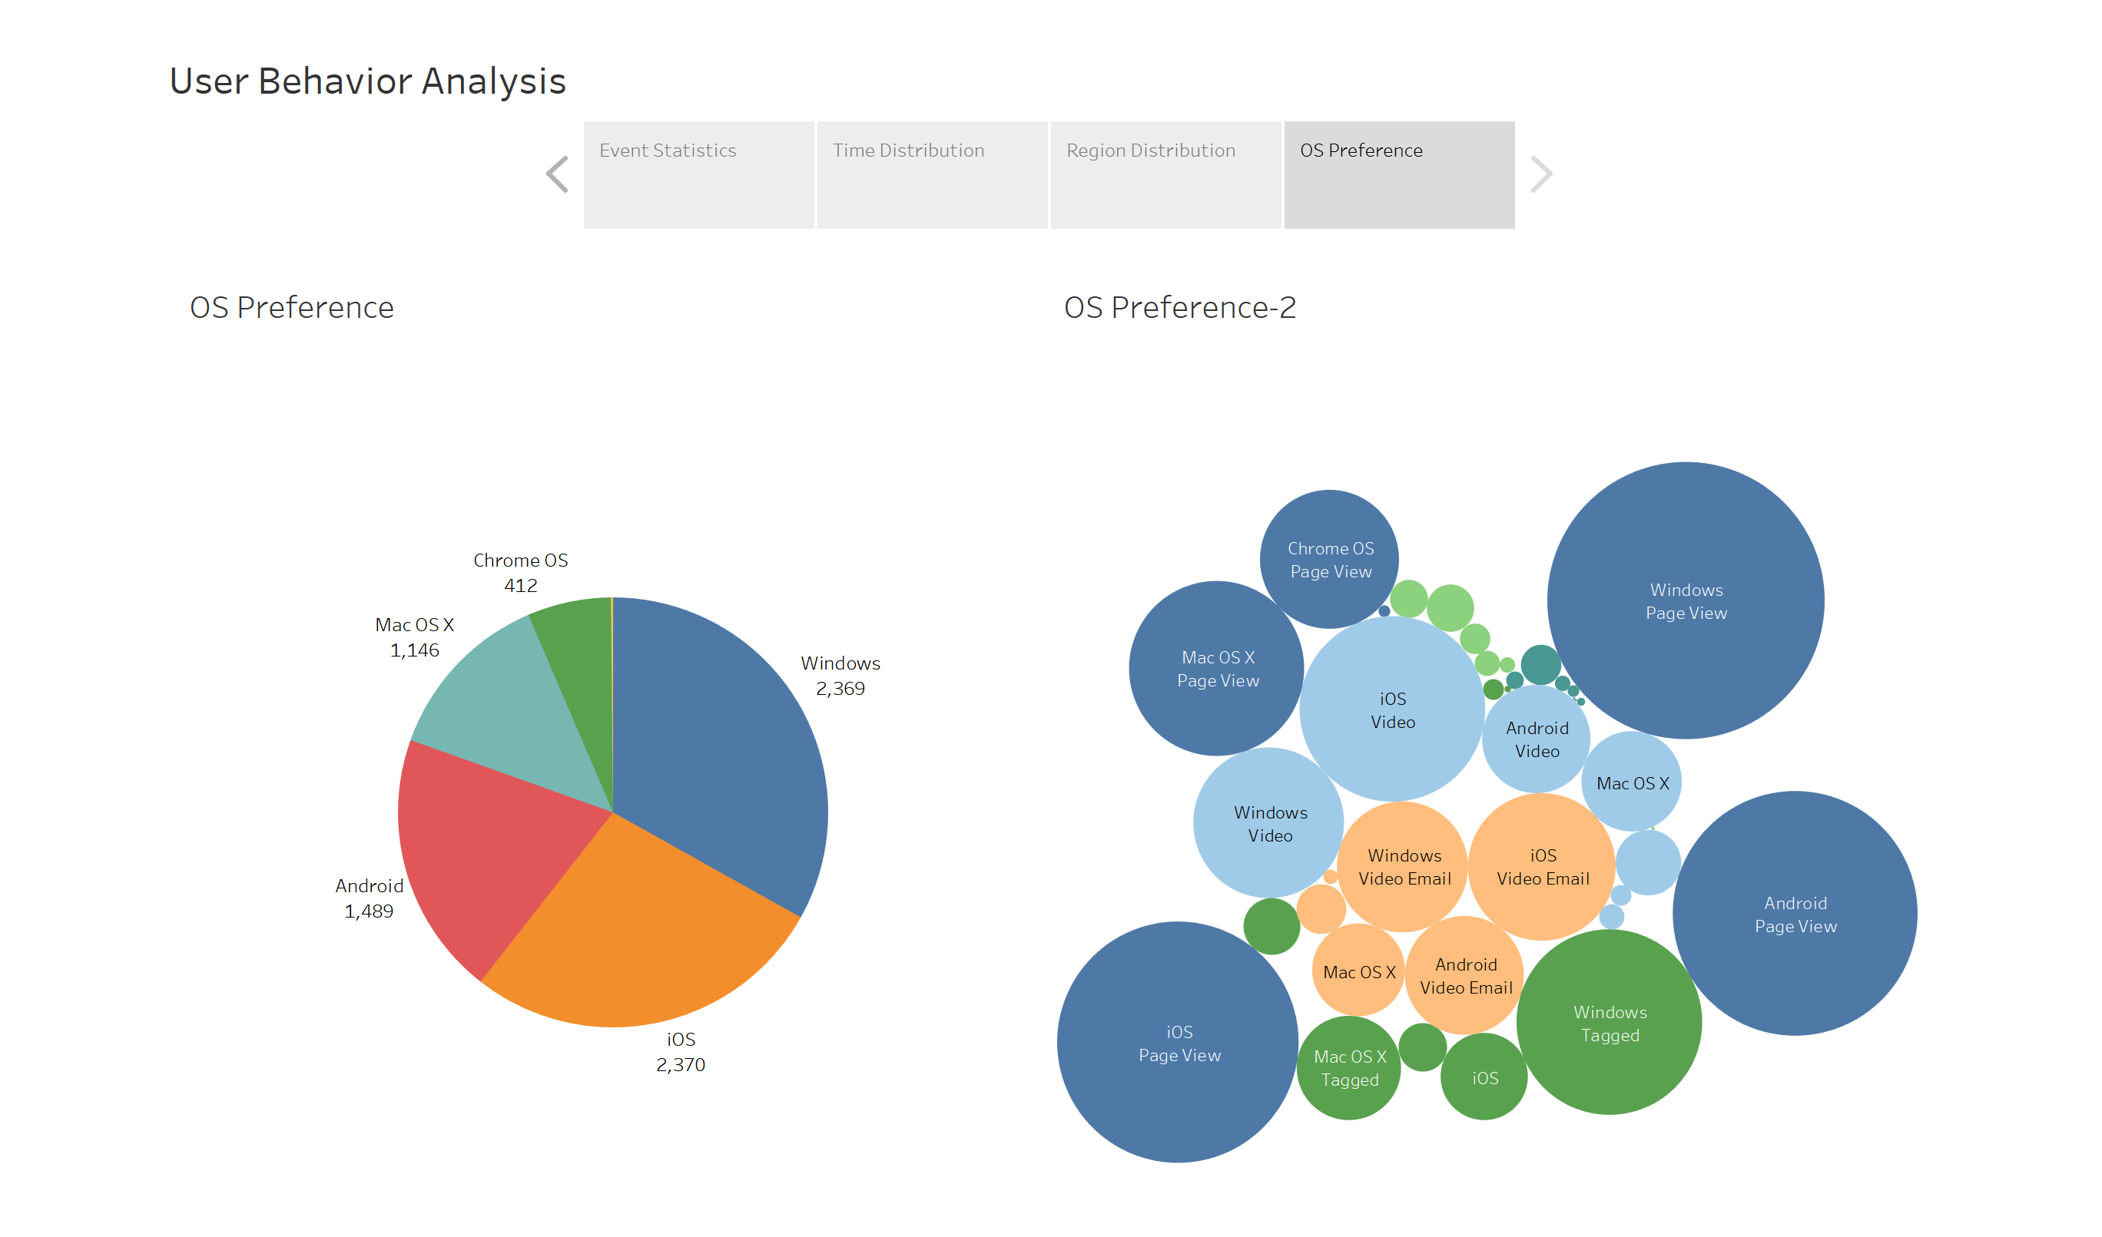

Slide 19
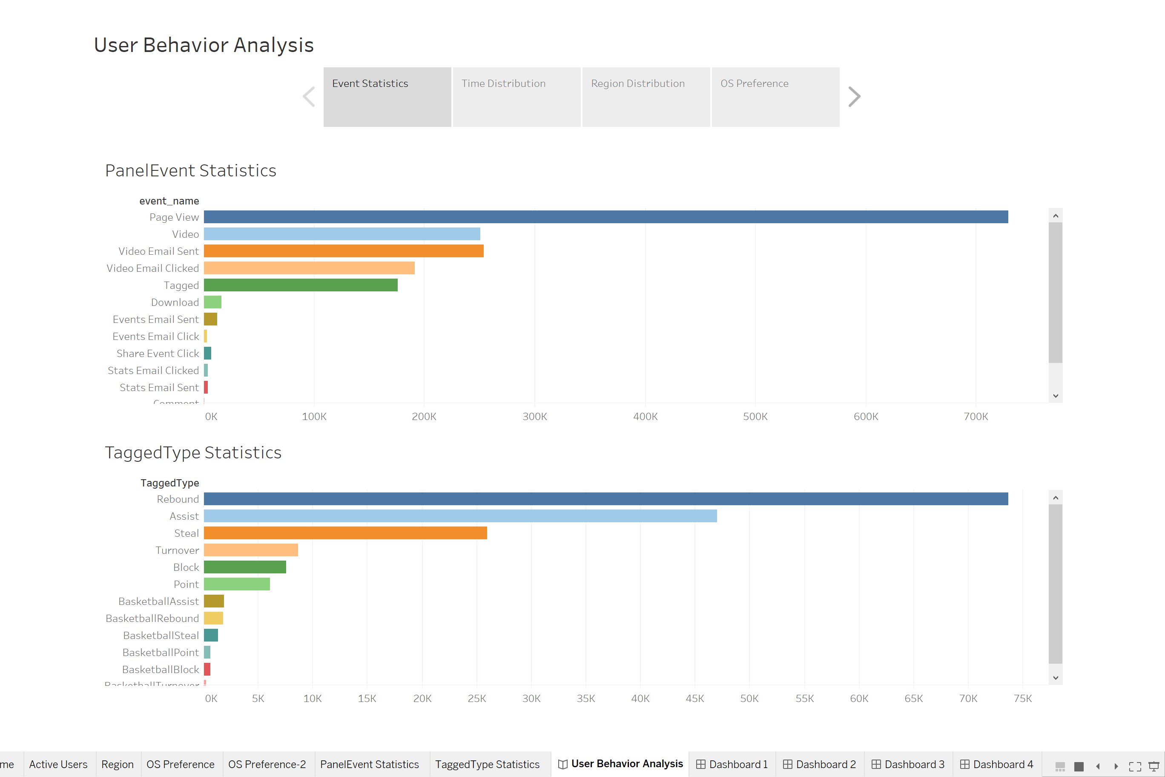

Slide 20
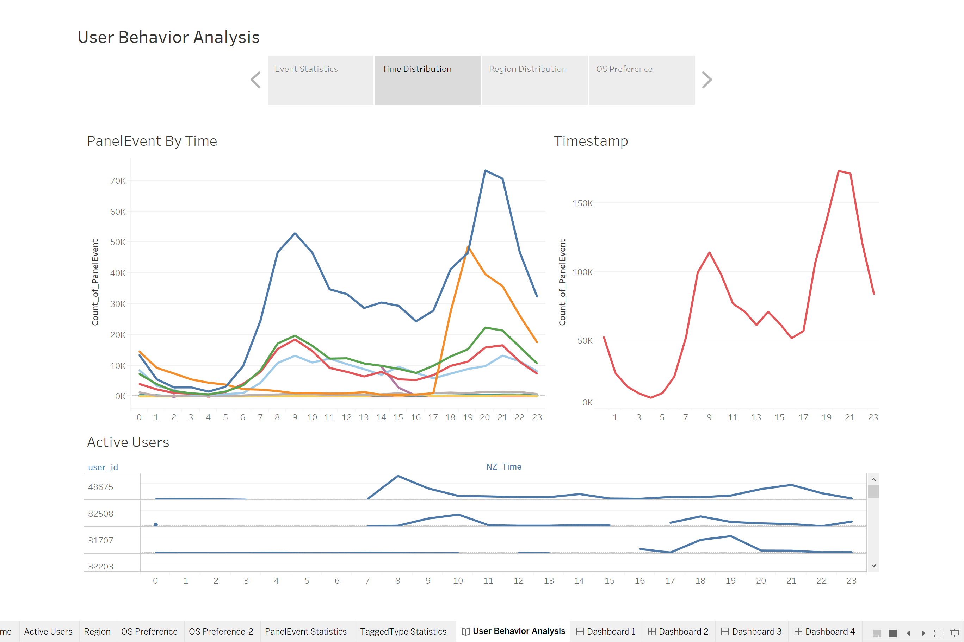
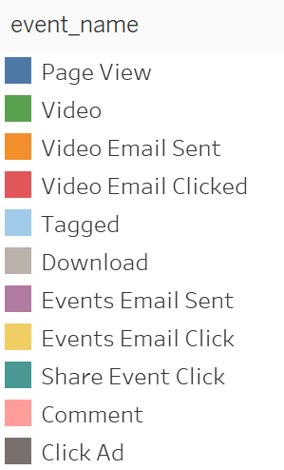

Slide 21

Sales & Marketing
Focus on the primary cities where most users live in.
Review of the good interactivity is beneficial to fund raising.
Priority of System Updating
Make better decisions regarding infrastructure investments according to the demand.
Dateline
Identify the best time to send event mail and video email to improve the click rate.
Conversion Rate
Find out the best time and best page(video) to advertise and target the advertisements to users.
Recommendation
Notes:
benefit the businesses and marketing strategies by finding the users' similarities.
help to extract useful information and knowledge about business and based on the finding and results of analysis to make decision and prediction on business development.
discovered the patterns regarding how, when, and where users interact with online applications

Slide 22
What I learnt
SQL/ BigQuery/ Database
Data Extraction&Transformation
Tableau
User Behaviour Analysis
Descriptive Analysis
Project Time Management

Slide 23
THANKS!
Any questions?

